Slide 1








PRODUCT
PRODUCT
INTRODUCTION
BUSI
-NESS
China High-tech Machinery and Equipment Manufacturing Enterprises
ZHUNFA MACHINE
Product Brochure
PRODUCT
PLAN
1
2
3
4
NEXT
https://www.jxcat.com/products/11438

Slide 2

Product Brochure
01.
02.
03.
Company Introduction
Product
Introduction
Product
Advantages
CONTENTS
1

Slide 3

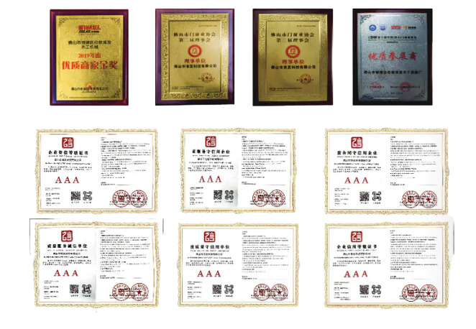
PART ONE
Product Brochure
Company Introduction
Zhunfa Machine is a high-tech machinery and equipment manufacturing enterprise integrating integrated integrated machinery design, research and development, manufacture, sales, and installation services. Sales and installation services are a high-tech machinery and equipment manufacturing enterprise. Focusing on woodworking machinery aluminum processing machinery and equipment research and development and production for nearly a decade, has become China's leading professional manufacturer of woodworking machinery and aluminum machinery and equipment.
Enterprises strictly implement international quality standards to produce each product, and its business throughout most of the domestic market, and exported to many countries and regions in Asia!
PRODUCT
2

Slide 4




Product Brochure
Company Mission
Technology, Services, Cooperate
01
02
03
Efficiency
Quality
Innovation
Our company is dedicated to producing high-quality mechanical equipment in the most efficient manner possible.
We are committed to stringent quality control practices at every stage of the manufacturing process.
Our dedication to innovation enables us to provide our customers with forward-thinking, customized equipment that adds value to their operations.
3

Slide 5

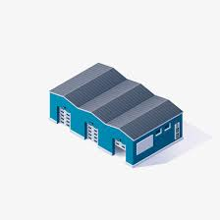

Product catalog
Product Brochure
PART TWO
Automatic Decoiling Machine
Automatic Feed Saw
90 Degree Precision Panel Saw
Straightening Machine with Grooving Function
Straightening Machine with Milling Groove Function
CNC Polygonal Bending Machine
Electric Bending Machine
Apple Light Box Bending Machine
Apple Light Box Punching Machine
Single Head Hinge Drilling Machine
Double Head Hinge Drilling Machine
Solid Wood Side Hole Drilling Machine
CNC 45 Degree Angle Drilling and Cutting Machine
Back Panel Grooving Machine
650 Stroke Transverse Machine
45 Degree Double Head Miter Saw
45 Degree Double Head Miter Saw (Dove Tail)
Fully Automatic 45 Degree Miter Saw
Vertical Lift 45 Degree Miter Saw (Cutting)
Vertical Lift 45 Degree Miter Saw (Non-Cutting)
350 Lift Table Angle Machine
405 Lift Table Angle Machine
Fully Automatic Vertical Lift Table Angle Machine
CNC Vertical Lift Miter Saw (Automatic Feed)
305 Single Head Sliding Miter Saw
Any Angle Cutting Machine
Sliding Door Saw
550 Fully Automatic Double End Saw
550 Manual Double End Saw
45 Degree Dedicated Double End Miter Saw
CNC Material Cutting Machine
CNC Polygonal Bending Machine
45 Degree Sliding Miter Saw
T-Bar Cutting Machine
CNC T-Bar Cutting Machine
Double Station Automatic Welding Machine
3m CNC Drilling and Milling Machine
3m CNC Double Head Drilling and Milling Machine
750 CNC Drill Washing Machine
90 Degree Hydraulic Shearing Machine
Fully Automatic Hydraulic Shearing Machine
700 Full Plate Shearing Machine
CNC Full Plate Drilling Machine
90 Degree Inverted Shearing Machine
Pneumatic Precision Shearing Machine
Single Head Bending Machine
Hydraulic Frame Joining Machine
Corner Joining Machine
Lock Catch Joining Machine
Automatic Screw Driving Machine
Panel Light Double End Saw
CNC Panel Light Miter Saw
Laser Corner Bonding Machine
CNC Positioning Pallet Rack
Alloy Saw Blades
4

Slide 6
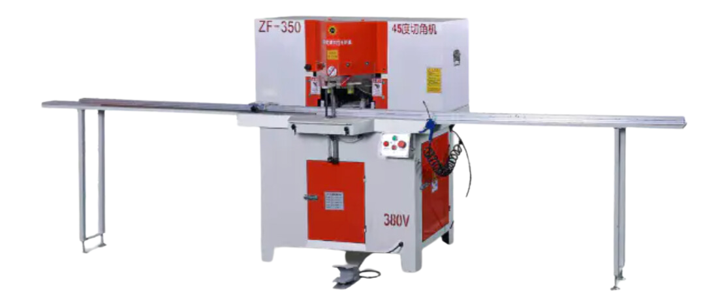
45 Degree Double Head Miter Saw
Product Brochure
45度双头切角机
PLAN
PRODUCT
Product Features
Dual Blade Aluminum Profile Miter Saw - This miter saw features dual blades to simultaneously cut two 45 degree miters in aluminum profiles, ensuring precise angles. It has automatic material clamping and cutting for fast, efficient operation. Ideal for aluminum framing applications such as picture frames, light box panels, doors, windows, cabinets, ceiling panel lights, solar panel aluminum frames, aluminum edging, AC vent outlets, diffuser frames, and more. The dual blade design allows quick, accurate diagonal miter cuts in aluminum, with integrated clamping to securely hold profiles during cutting. Perfect for high-volume aluminum fabrication shops producing framed products.
5

Slide 7
45 Degree Double Head Miter Saw
Product Brochure
45度双头切角机
PLAN
PRODUCT
Product Features
Dual Blade Aluminum Profile Miter Saw - This miter saw features dual blades to simultaneously cut two 45 degree miters in aluminum profiles, ensuring precise angles. It has automatic material clamping and cutting for fast, efficient operation. Ideal for aluminum framing applications such as picture frames, light box panels, doors, windows, cabinets, ceiling panel lights, solar panel aluminum frames, aluminum edging, AC vent outlets, diffuser frames, and more. The dual blade design allows quick, accurate diagonal miter cuts in aluminum, with integrated clamping to securely hold profiles during cutting. Perfect for high-volume aluminum fabrication shops producing framed products.
5

